Slide 1

Natural Language Processing Project
Recipe Search Application
Presenter: 20140313 양인수
TEAM 자연어버억
MEMBERS:
20163704 박주현
20164245 홍진
20140490 이동규
20176058 박시현
20142748 이강희
20140313 양인수
Notes:
本PPT模板部分元素使用了幻灯片母版制作。如果需要修改，点击-视图-幻灯片母版-修改；完成后关闭编辑母版即可。

Slide 2
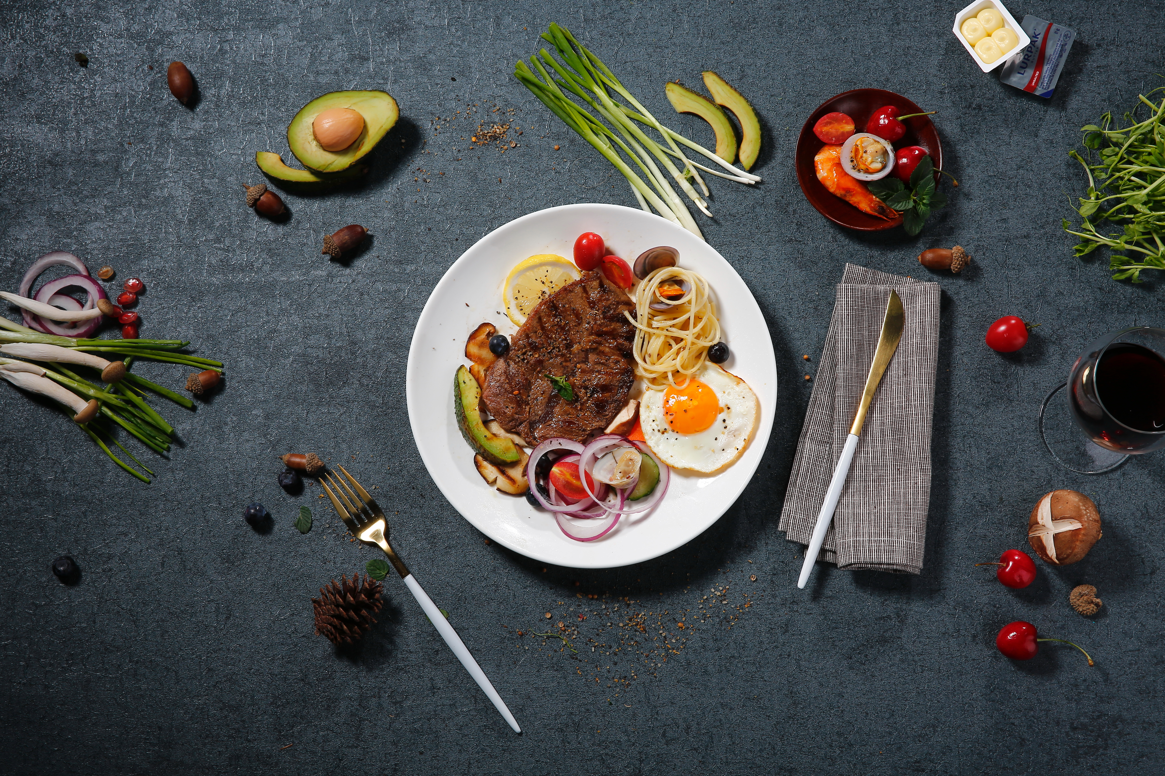
01 Introduction
CONTENTS
02 Progress
03 Schedule

Slide 3
01
Introduction
Topic

Slide 4



Topic
NL query
Matching
Dish
Building a system that understands natural language query.
Search also by the ingredients.

Slide 5
02
Progress
Data Mining
Preprocessing, Modeling
Evaluation

Slide 6
Project Topic
Data Mining
2. Preprocessing & Modeling
3. Evaluation

Slide 7
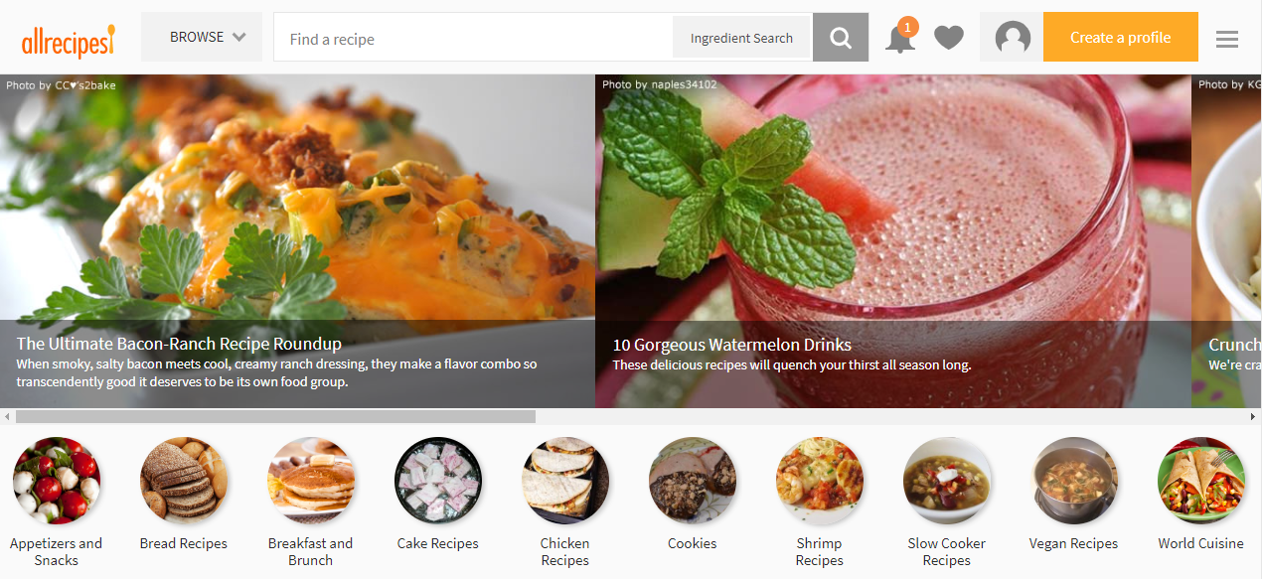
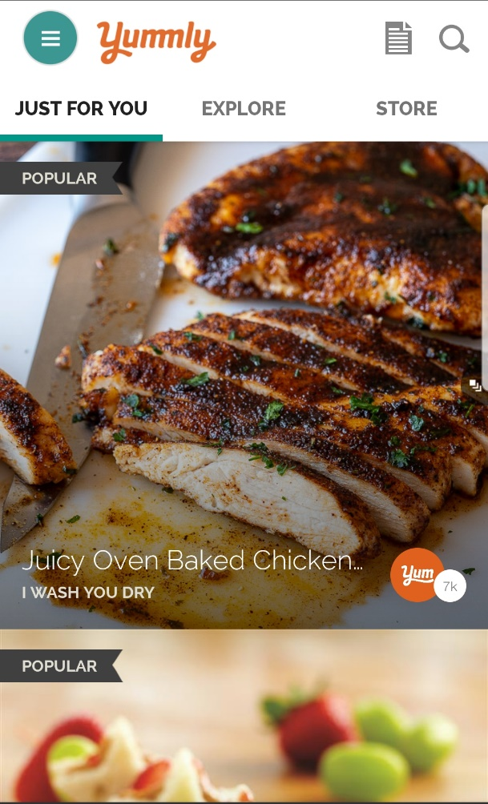
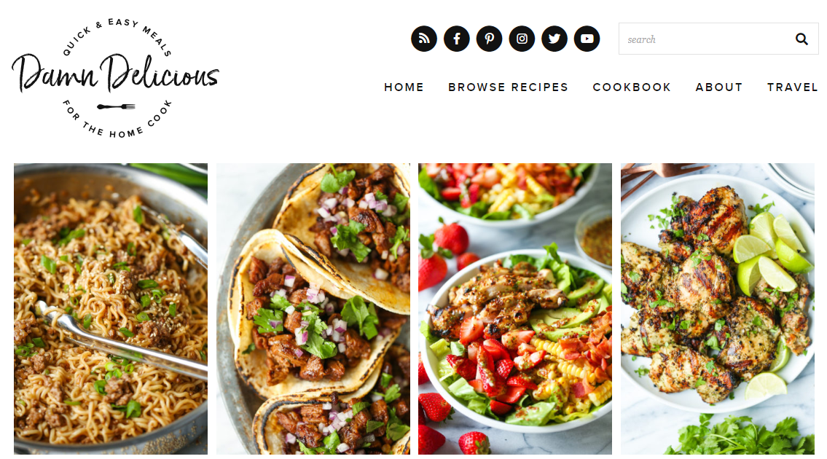
Data Collection
-Format reformation
-Currently 100 datas, to be added more
Notes:
Yummly, allrecipes, Damn Delicous에서 요리에 대한 정보를 가져왔습니다.

Slide 8
Query Preprocessing
Query:
Tasty
Boiling
Chicken
Soup
NLTK Library
Delicious
Yummy
Appetizing
Savory
Hot
Warm
Sizzling
*randomly generates 10 queries
Delicious Hot
Chicken Soup
Delicious Warm
Chicken Soup
result
Yummy Hot
Chicken Soup
Yummy Warm
Chicken Soup
Notes:
Yummly, allrecipes, Damn Delicous에서 요리에 대한 정보를 가져왔습니다.

Slide 9
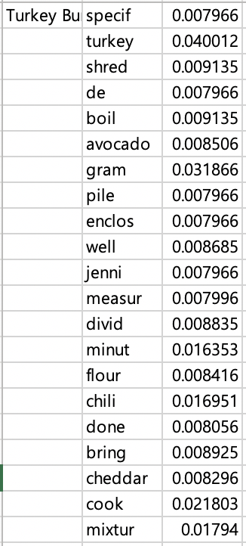
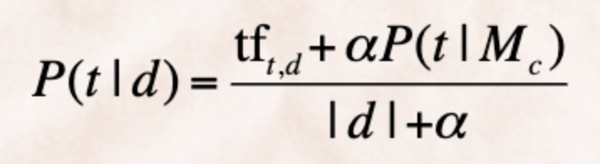
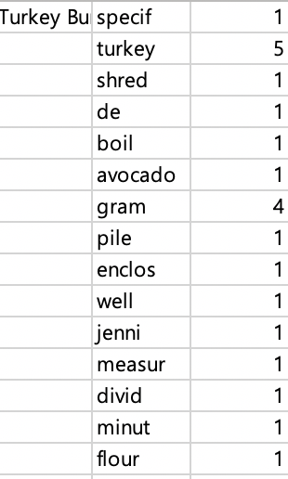
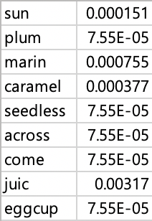
Modeling
Dirichlet Smoothing:
P(t|d)
TF
DF
*a Value defaulted by 0.5
Notes:
Yummly, allrecipes, Damn Delicous에서 요리에 대한 정보를 가져왔습니다.

Slide 10

Matching
P(t|d)
- Takes the average of the randomly created 10 queries.
Notes:
Yummly, allrecipes, Damn Delicous에서 요리에 대한 정보를 가져왔습니다.

Slide 11
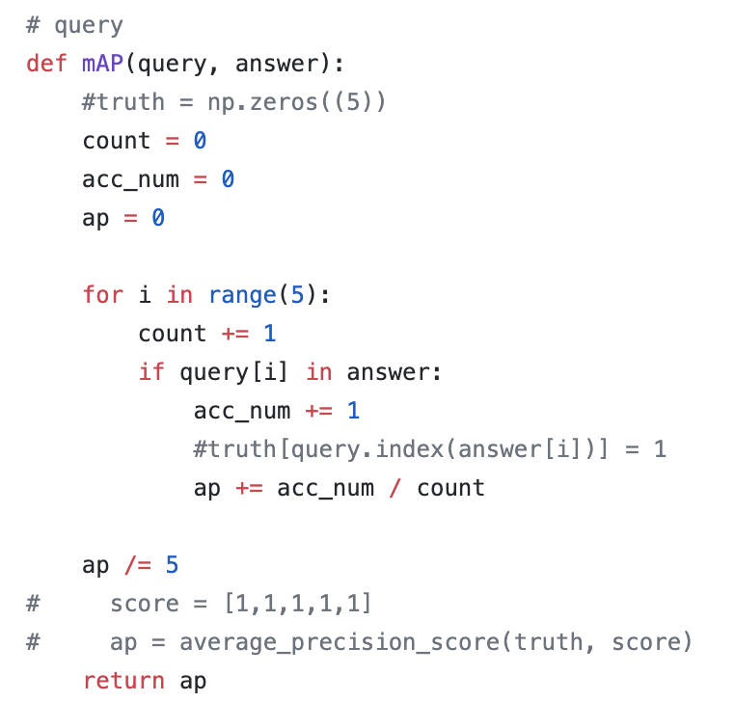
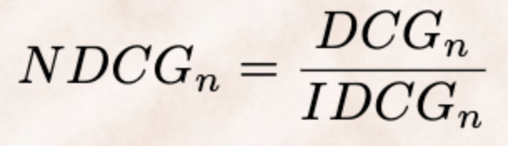
Evaluation
NDCG
Relevant Results are being made.
(ideal case of the IR system.)
Notes:
Yummly, allrecipes, Damn Delicous에서 요리에 대한 정보를 가져왔습니다.

Slide 12
03
Schedule

Slide 13
Schedule
WEEK 1
WEEK 2
WEEK 3
WEEK 4
01
02
03
04
WEEK 1
WEEK 2
WEEK 3
WEEK 4
Data Mining
Data Processing
Query Processing
(Machine Learning)
IR system Modeling
& Evaluation
Evaluation & Model Improvement
Front Development

Slide 14
Thank You.
This is the end of our presentation.
Notes:
本PPT模板部分元素使用了幻灯片母版制作。如果需要修改，点击-视图-幻灯片母版-修改；完成后关闭编辑母版即可。

